Slide 1
Hotel Reservation using Hibernate and Maven
Vishnu Priya C (EBEON1222710971)
Santhiyadevi KK (EBEON12227110971)
Harini Akshaya K (EBEON1222698864)
Pavithra (EBEON1222704165)
Guided by:
Varadharajan (Trainer)

Slide 2
ELITE INN ALL MODULE DETAILS
ADMIN MODULE
Manage Category
Manage Product
Manage Order
Manage User
View Bill
Change Password

Slide 3
ELITE INN ALL MODULE DETAILS
AUTHENTICATION MODULE
Sign up
Login
USER MODULE
Manage Order
View Bill
Change Password

Slide 4
ELITE INN – USER MODULE
SUBMODULES
MANAGE ORDER
VIEW BILL

Slide 5
MANAGE ORDER
This module allows the user to book their room.
The user is given options to choose the type of room that they want.
There are 5 categories available namely:
Standard Room
Deluxe Room
Suite
Conference Hall
Banquet Hall
The above categories further divide into different room types according to the size and amenities.

Slide 6
MANAGE ORDER
The user has to fill in their details to proceed with the booking.
The price and the total is auto-filled accordingly when user selects their desired rooms.
The rooms added by the user will be displayed in the bottom of the page.
When the order is submitted , the bill is generated.

Slide 7
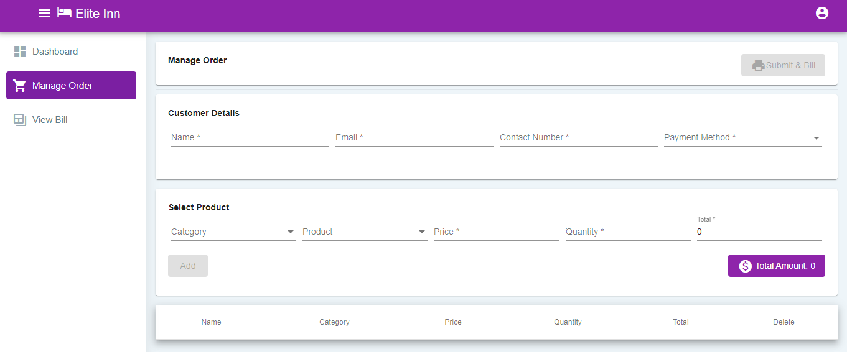
OUTPUT DEMO

Slide 8
VIEW BILL
This module allows the user to view the bill of the rooms that they have booked.
There is a filter option which helps the user to sort the bills according to their name/payment method.
The user can view, download or delete the bill.
Dependencies used:
Itextpdf
Apache.pdfbox

Slide 9
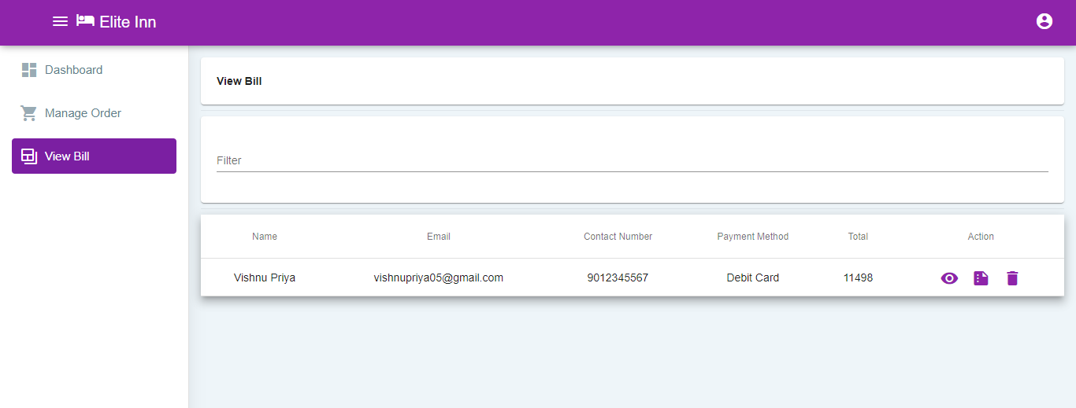
OUTPUT DEMO

Slide 10
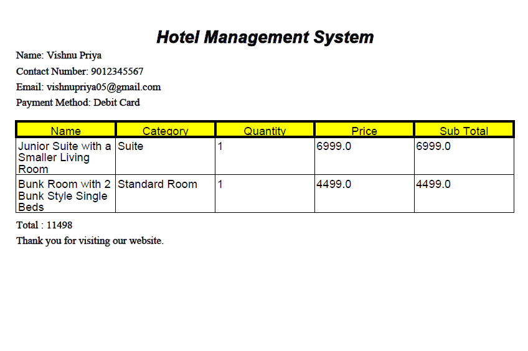
OUTPUT DEMO

Slide 11
TECHNOLOGIES USED
FRONT END
BACK END
DATABASE
HTML
CSS
BOOTSTRAP
JAVASCRIPT
ANGULAR
JAVA
HIBERNATE
SPRING
MYSQL

Slide 12
PROJECT ARCHITECTURE
Manage Category
Admin
Manage Product
Manage User
Manage Order
Sign up
Login
Dash Board
View Bill
Change Password
Manage Order
Submit
View Bill
User
Change Password

Slide 13
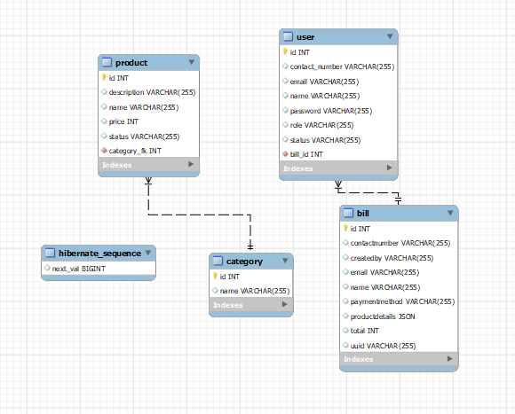
EER DIAGRAM OF OUR PROJECT DB

Slide 14
FUTURE ENHANCEMENTS
To attach description with room details while booking.
Need to include Calendar.
To send bill copy to user’s email.

Slide 15
THANK YOU

